Slide 1
CIMI Modelling Taskforce Report
Dr Linda Bird
11th April 2013

Slide 2
Laboratory models

Slide 3
Submitted Models
FHIR Lab Report resource
Intermountain Standard Lab Obs
NEHTA Pathology Test Result
MOHH Investigation Composition
HL7 Clinical Care Document
Netherlands (NFU) Lab Results
EN13606 Assoc Lab Test
Canada InfoWay HL7 v3 POLB_MT004000UV

Slide 4
Archetype Map for
Laboratory Results Report
Composition:
Laboratory Results Report

Slide 5
Archetype Map for
Laboratory Results Report
Composition:
Laboratory Results Report
Laboratory Report Header
Laboratory Test Observation
Entry:
Patient Encounter Summary
Laboratory Test Request Summary

Slide 6
Archetype Map for
Laboratory Results Report
Composition:
Laboratory Results Report
Laboratory Report Header
Laboratory Test Observation
Entry:
Patient Encounter Summary
Laboratory Test Request Summary
Cluster:
Laboratory Test Observable
Laboratory Test Result Group
Action
Laboratory Test Request
Specimen
Laboratory Test Observable
Reference Range
Action
Action
Action

Slide 7
Composition
Laboratory Results Report
COMPOSITION
constrains
Clinical Report
constrains
Laboratory Results Report

Slide 8
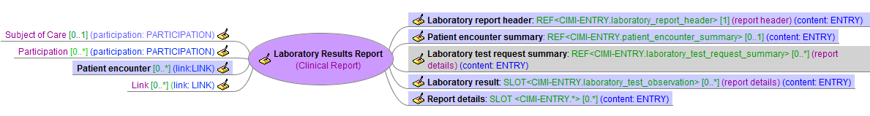
CIMI-COMPOSITION.laboratory_results_report
COMPOSITION
constrains
Clinical Report
constrains

Slide 9
Entry
Laboratory Report Header
ENTRY
constrains
Clinical Entry
constrains
Clinical Report Header
constrains
Laboratory Report Header

Slide 10
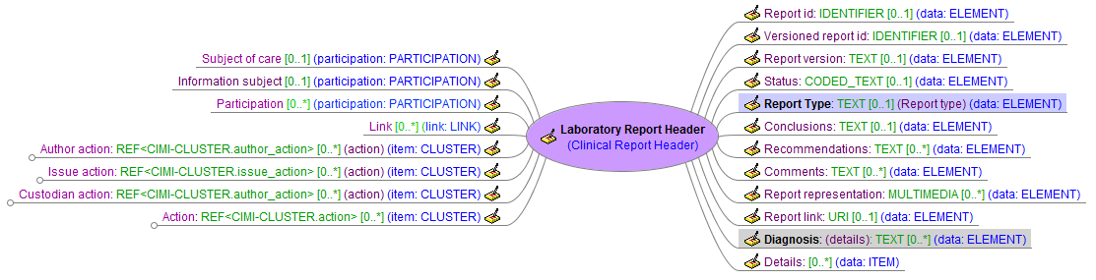
CIMI-ENTRY.laboratory_report_header
ENTRY
constrains
Clinical Entry
constrains
Clinical Report Header
constrains

Slide 11
Entry
Patient Encounter Summary
ENTRY
constrains
Clinical Entry
constrains
Clinical Activity
constrains
Patient Encounter Summary

Slide 12
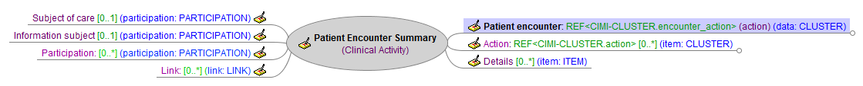
CIMI-ENTRY.patient_encounter_summary
ENTRY
constrains
Clinical Entry
constrains
Clinical Activity
constrains

Slide 13
Entry
Laboratory Test Request Summary
ENTRY
constrains
Clinical Entry
constrains
Clinical Activity
constrains
Request
constrains
Observation Request
constrains
Laboratory Test Request Summary

Slide 14
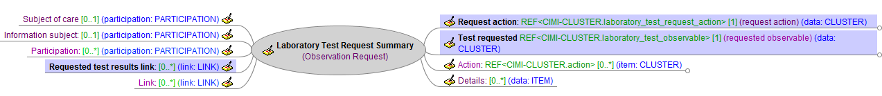
CIMI-ENTRY.laboratory_test_request_ summary
ENTRY
constrains
Clinical Entry
constrains
Clinical Activity
constrains
Request
constrains
Observation Request
constrains

Slide 15
Entry
Laboratory Test Observation
ENTRY
constrains
Clinical Entry
constrains
Observation
constrains
Laboratory Test Observation

Slide 16
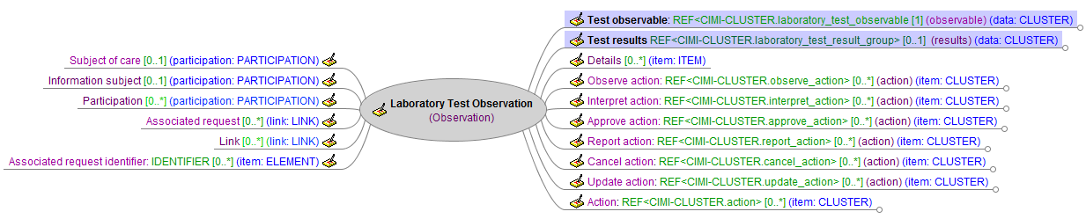
CIMI-ENTRY.laboratory_test_observation
ENTRY
constrains
Clinical Entry
constrains
Observation
constrains

Slide 17
Archetype Map for
Laboratory Results Report
Composition:
Laboratory Results Report
Laboratory Report Header
Laboratory Test Observation
Entry:
Patient Encounter Summary
Laboratory Test Request Summary
Cluster:
Laboratory Test Observable
Laboratory Test Result Group
Action
Laboratory Test Request
Specimen
Laboratory Test Observable
Reference Range
Action
Action
Action

Slide 18
Cluster
Laboratory Test Observable
CLUSTER
constrains
Observable
constrains
Laboratory Test Observable

Slide 19
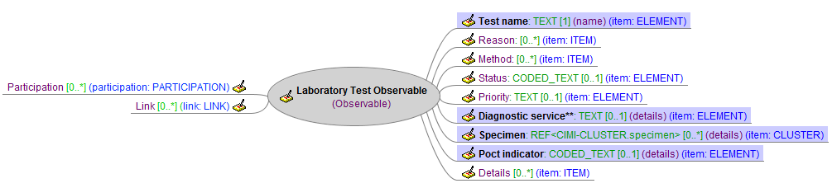
CIMI-CLUSTER. laboratory_test_observable
CLUSTER
constrains
Observable
constrains

Slide 20
Cluster
Laboratory Test Result Group
CLUSTER
constrains
Finding
constrains
Finding Group
constrains
Laboratory Test Result Group

Slide 21
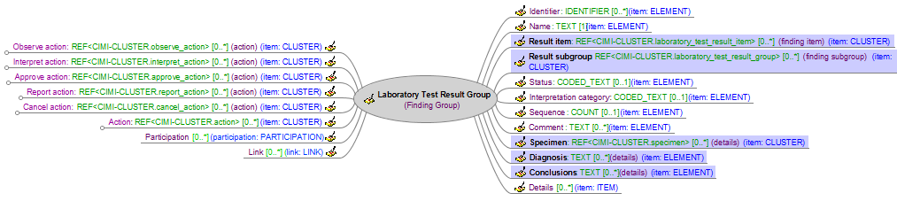
CIMI-CLUSTER. laboratory_test_result_group
CLUSTER
constrains
Finding
constrains
Finding Group
constrains

Slide 22
Cluster
Laboratory Test Result Item
CLUSTER
constrains
Finding
constrains
Finding Item
constrains
Laboratory Test Result Item

Slide 23
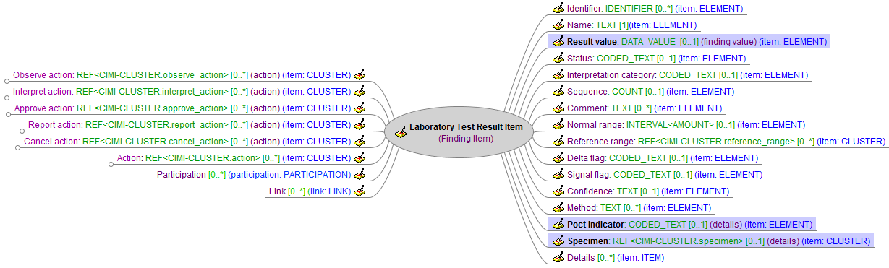
CIMI-CLUSTER. laboratory_test_result_item
CLUSTER
constrains
Finding
constrains
Finding Item
constrains

Slide 24
Cluster
Reference Range
CLUSTER
constrains
Finding
constrains
Finding Item
constrains
Reference Range

Slide 25
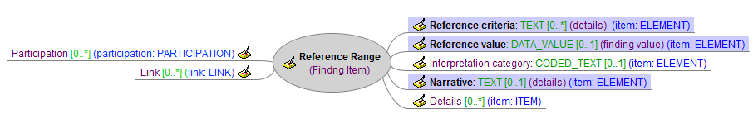
CIMI-CLUSTER.reference_range
CLUSTER
constrains
Finding
constrains
Finding Item
constrains

Slide 26
Cluster
Specimen
CLUSTER
constrains
Material Entity
constrains
Specimen

Slide 27
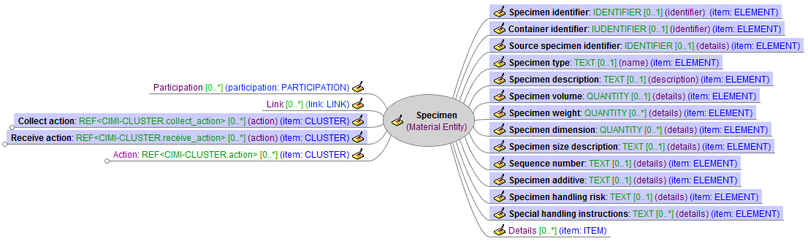
CIMI-CLUSTER.specimen
CLUSTER
constrains
Material Entity
constrains

Slide 28
Cluster
Specimen Collection Site
CLUSTER
constrains
Material Entity
constrains
Anatomical Location
constrains
Specimen Collection Site

Slide 29
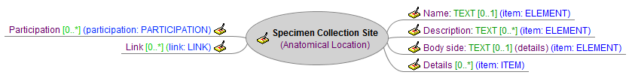
CIMI-CLUSTER.specimen_collection_site
CLUSTER
constrains
Material Entity
constrains
Anatomical Location
constrains

Slide 30
CLUSTER
Laboratory Actions
CLUSTER
Action
Encounter Action
Collect Action
Observe Action
Receive Action
Interpret Action
Author Action
Approve Action
Issue Action
Report Action
Custodian Action
Cancel Action
Request Action
Requested Action
Laboratory Test Request Action

Slide 31
Cluster
Laboratory Test Request Action
CLUSTER
constrains
Action
constrains
Request Action
constrains
Laboratory Test Request Action

Slide 32
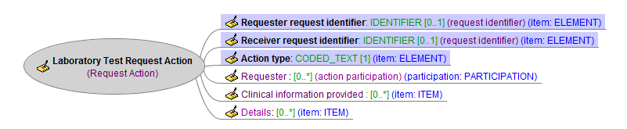
CIMI-CLUSTER. laboratory_test_request_action
CLUSTER
constrains
Action
constrains
Request Action
constrains

Slide 33
Cluster
Approve Action
CLUSTER
constrains
Action
constrains
Approve Action

Slide 34
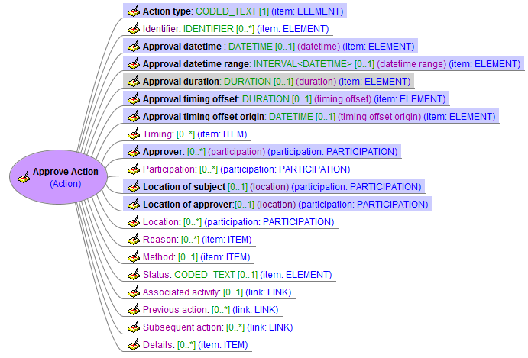
CIMI-CLUSTER.approve_action
CLUSTER
constrains
Action
constrains

Slide 35
Laboratory model specialisations

Slide 36
Laboratory Model Specialisations
Complete Blood Count with Manual Differential Panel
Complete Blood Count with Auto Differential Panel
Complete Blood Count without Differential
Gas and Carbon Monoxide Panel

Slide 37
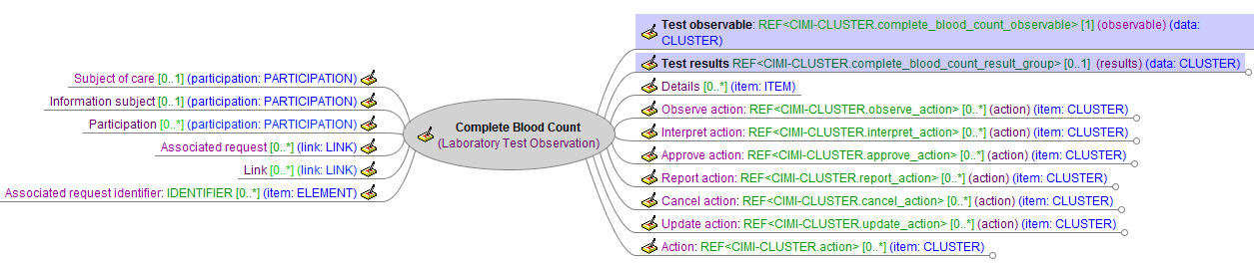
Complete Blood Count
ENTRY
constrains
Clinical Entry
constrains
Observation
constrains
Laboratory Test Observation
constrains

Slide 38
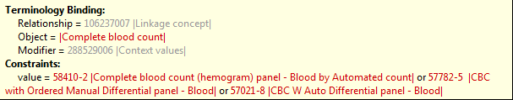
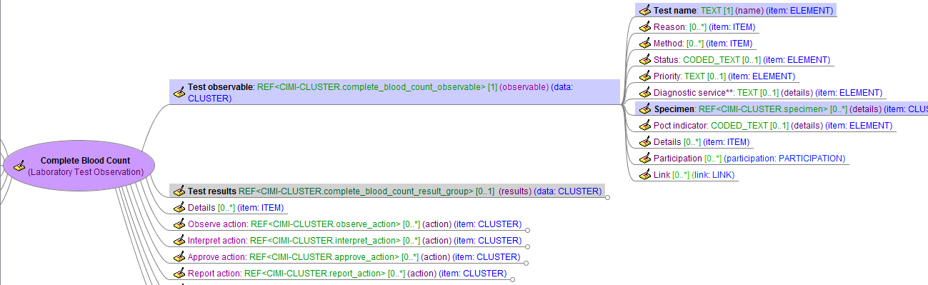

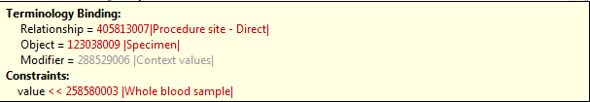
Complete Blood Count

Slide 39
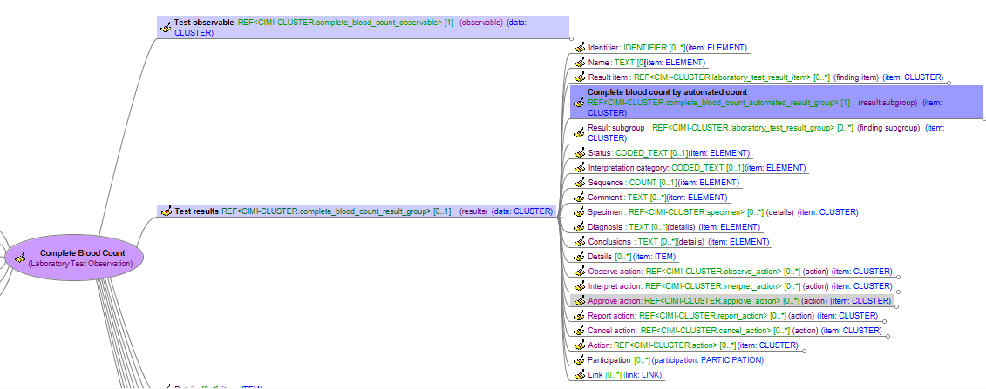
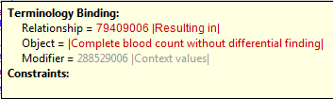

Complete Blood Count

Slide 40
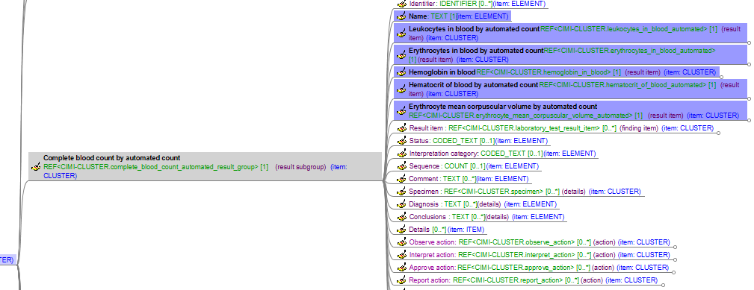
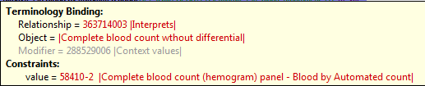

Complete Blood Count

Slide 41
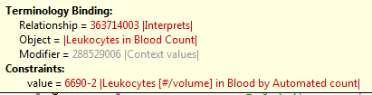
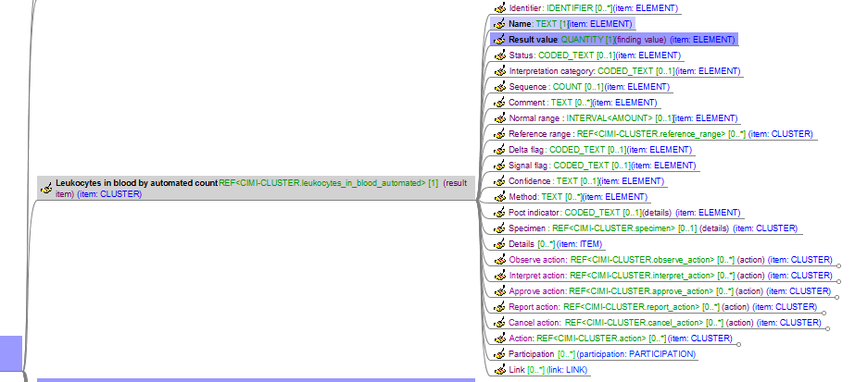
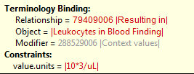
Complete Blood Count

Slide 42
Complete Blood Count Specialisations
ENTRY
constrains
Clinical Entry
constrains
Observation
constrains
Laboratory Test Observation
constrains
Complete Blood Count
constrains
constrains
constrains
Complete Blood Count Without Differential
Complete Blood Count With Auto Differential
Complete Blood Count With Manual Differential

Slide 43
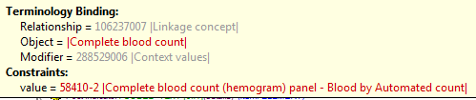
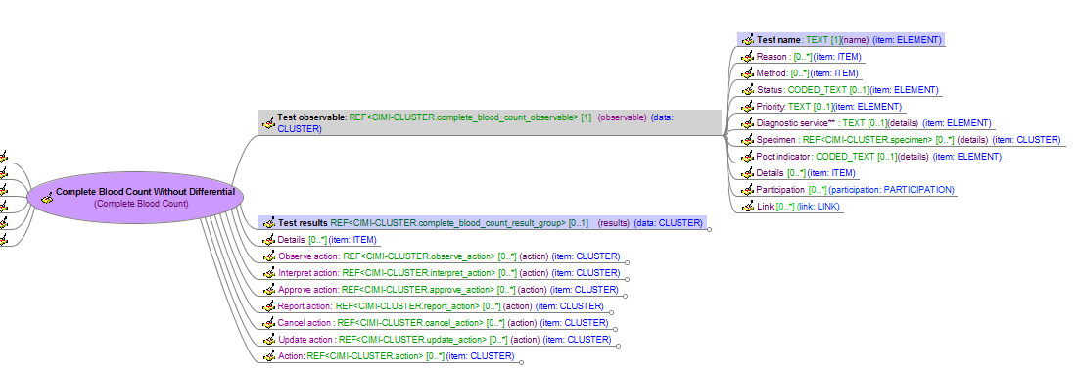
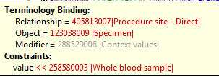

Complete Blood Count Without Differential

Slide 44

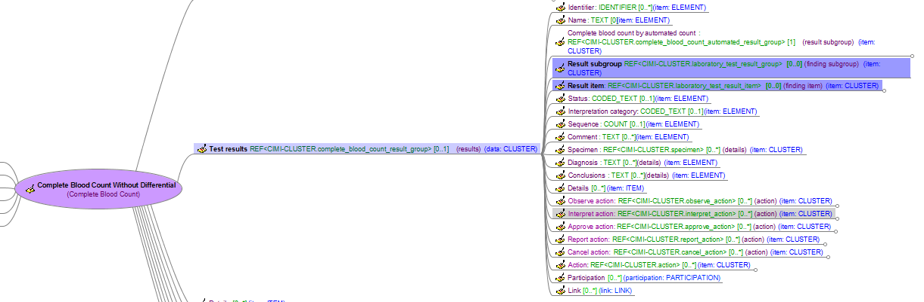
Complete Blood Count Without Differential

Slide 45
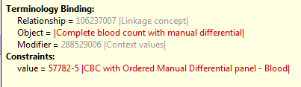
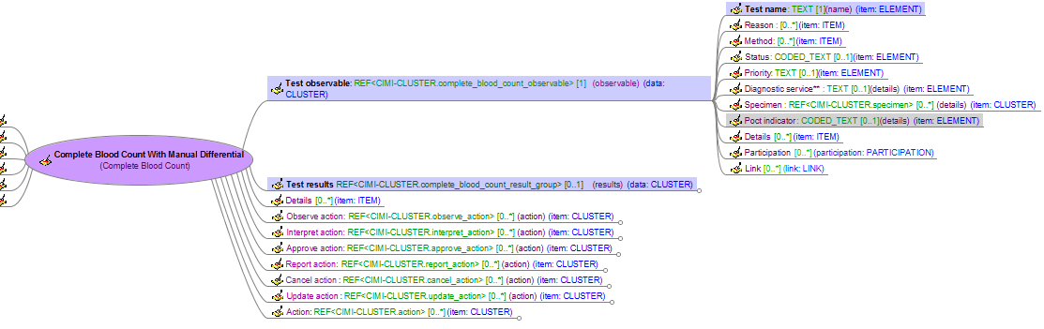

Complete Blood Count With Manual Differential

Slide 46

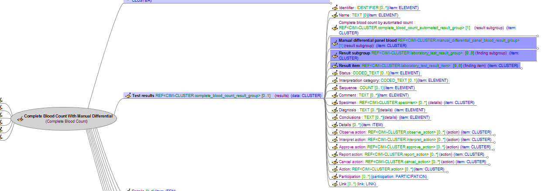

Complete Blood Count With Manual Differential Panel

Slide 47
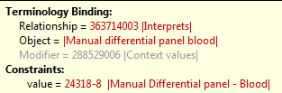
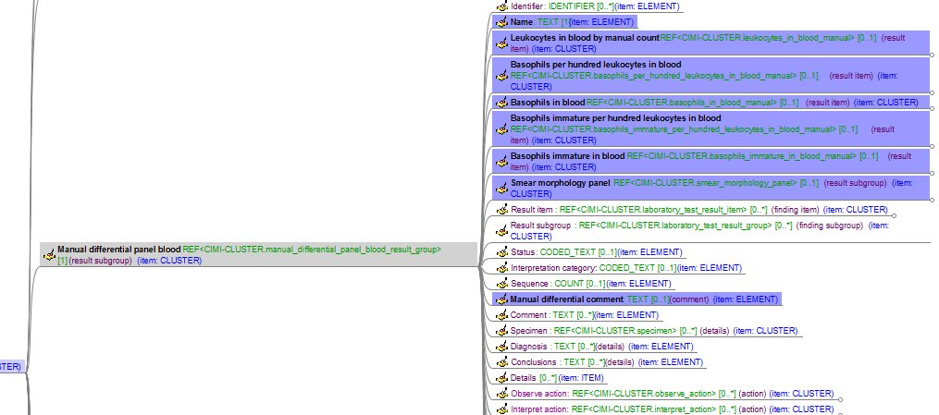

Complete Blood Count With Manual Differential Panel

Slide 48
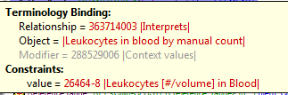
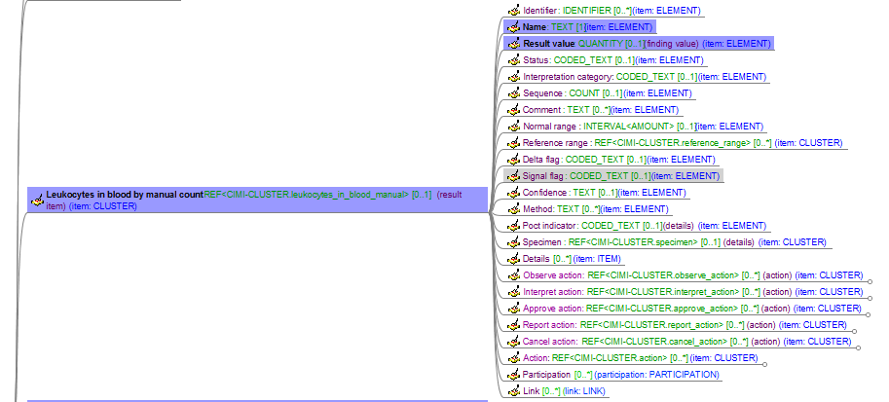
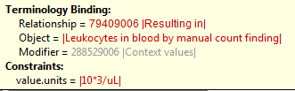

Complete Blood Count With Manual Differential Panel

Slide 49
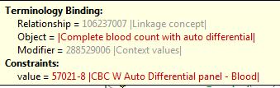
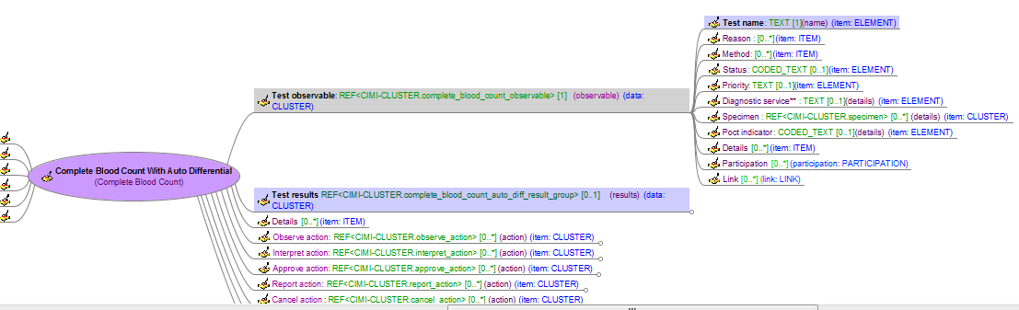

Complete Blood Count With Auto Differential

Slide 50

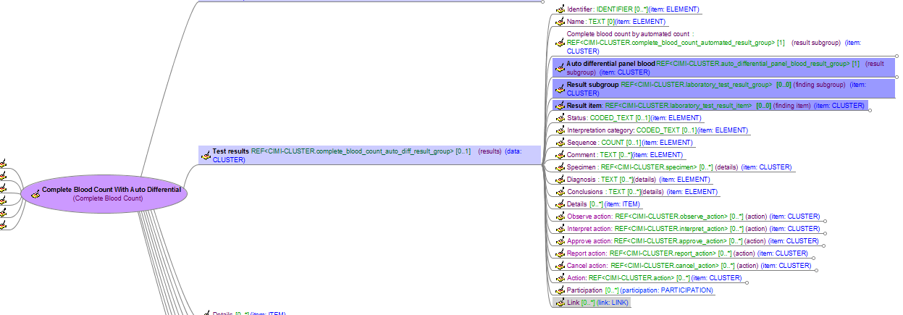

Complete Blood Count With Auto Differential Panel

Slide 51
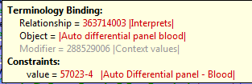
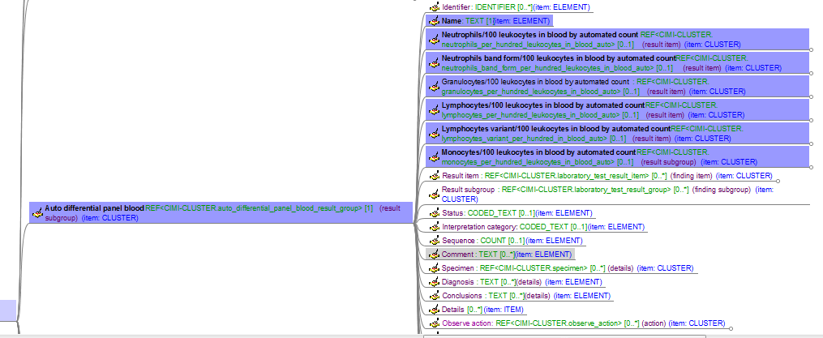


Complete Blood Count With Auto Differential Panel

Slide 52
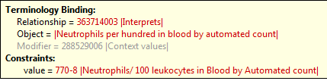
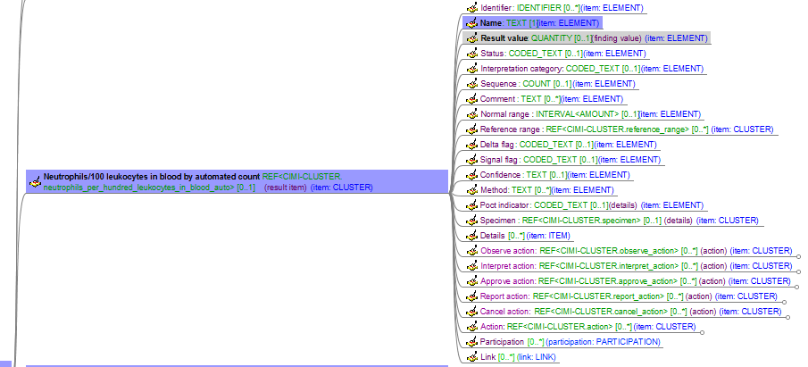
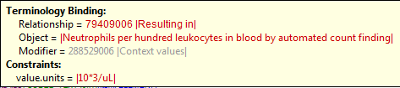
Complete Blood Count With Auto Differential Panel

Slide 53
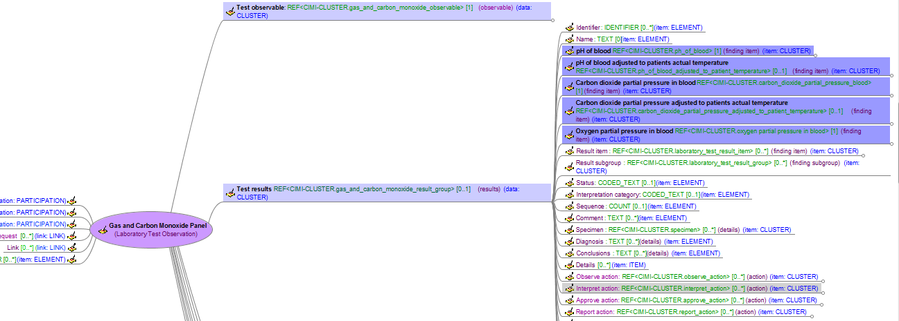

Gas and Carbon Monoxide Panel

Slide 54
Demographics models

Slide 55
Participation & Party Reference Model

Slide 56
When is demographics demographics?
Question: When is CIMI information modelled using the ‘PARTY’ model, and when is it modelled using the core reference model?
Proposed Criteria:
Does the information relate to a specific healthcare event or not?
Does it record the results of an observation, evaluation, assessment, or activity?
If yes, then use Core Reference Model
E.g. Age is specific to a point in time, Living Dependency is an assessment and Biologic Sex is an observation
Is this information only relevant to the Subject of Care, or do we need to record this about other Parties participating in the record as well?
If needed about other Parties, then usually use Party model
E.g. Address may be relevant for Next of Kin; Disability may be relevant for a Dependent
How is it commonly used in systems?
Source models are used to determine common implementation practice

Slide 57
Demographics Source Models
HL7 v3 RIM
NHS LRA
NEHTA (Participation)
FHIM (Federal Health Information Model) Demographics model
HL7 FHIR (Organisation, Person, Patient, Agent, Group)
openEHR
ISO13606 (Standard and new draft)
ISO-22220
MOHH (Singapore)
DCM (The Netherlands)
Intermountain Healthcare

Slide 58
CIMI Demographics Models
CLUSTER
Location
Address
Electronic Contact
Party Name
PARTY
ACTOR
Person
Organisation
ROLE
Person Role
Healthcare Consumer
Healthcare Provider
Healthcare Provider Individual
Healthcare Provider Organisation

Slide 59
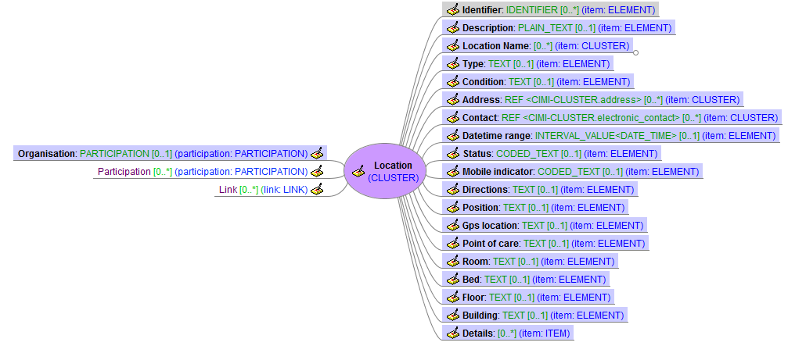
Location
CLUSTER
constrains

Slide 60
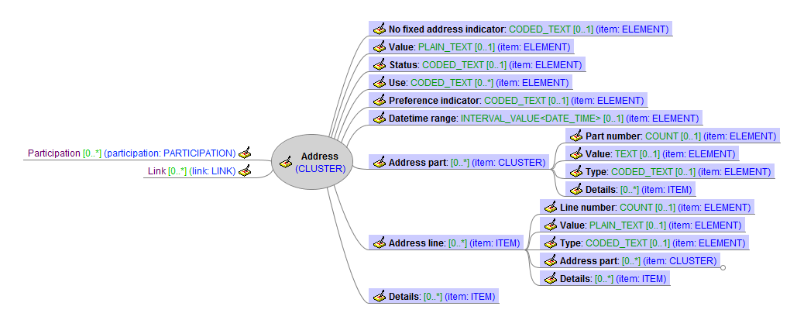
Address
CLUSTER
constrains

Slide 61
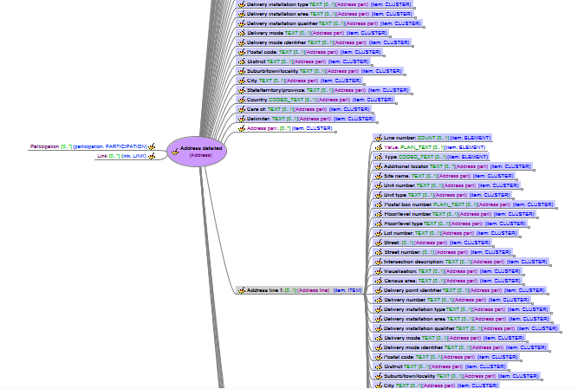
Address Detailed
CLUSTER
constrains
Address
constrains

Slide 62
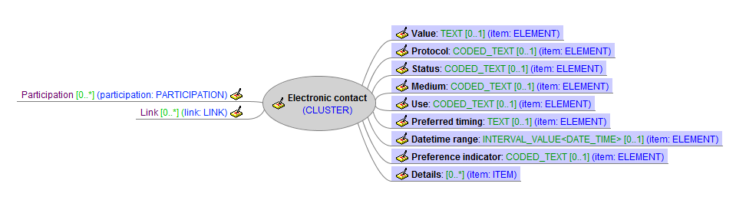
Electronic Contact
CLUSTER
constrains

Slide 63

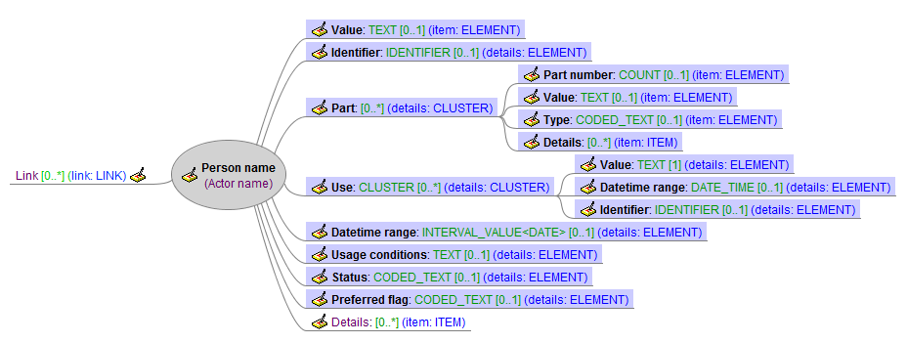
Party Name
CLUSTER
constrains
constrains
Actor Name
constrains

Slide 64

Party Name
Person Name
constrains

Slide 65

Party
PARTY
constrains

Slide 66

Actor
PARTY: ACTOR
constrains
Party
constrains

Slide 67


Person
Party
constrains
Actor
constrains

Slide 68

Organisation
Party
constrains
Actor
constrains

Slide 69

Role
PARTY: ROLE
constrains
Party
constrains

Slide 70

Person Role
Party
constrains
Role
constrains

Slide 71

Healthcare Consumer
Party
constrains
Role
constrains
Person Role
constrains

Slide 72

Healthcare Provider
Party
constrains
Role
constrains

Slide 73

Healthcare Provider Individual
Party
constrains
Role
constrains
Healthcare Provider
constrains

Slide 74

Healthcare Provider Organisation
Party
constrains
Role
constrains
Healthcare Provider
constrains

Slide 75
Future work

Slide 76
Future Work
Foundations
Reference model
Documentation and implementation
Archetype object model
Extensions to support terminology
Modelling patterns
Documentation and terminology bindings
Add new patterns to support new models
Style guides
Complete content
Models
Laboratory Results models
Add instances, specialisations and complete terminology bindings
Immunization models
Temperature and other priorities
Implementation
Generate ADL 1.5 for all modelling patterns and models
Build modelling foundations in tooling infrastructure
Create associated tooling, including instance generation and visualisations
Create transformations to priority implementation formats
Governance
Establish modelling development, review and publication processes and procedures

Slide 77
Online References
CIMI Web Page
http://informatics.mayo.edu/CIMI
Google doc repository
http://content.clinicalmodels.org
Google groups email list (cimi-modelling-taskforce)
http://groups.google.com/group/cimi-modelling-taskforce?hl=en-GB
Issue tracking (github)
https://github.com/clinicalmodels/cimi/

Slide 78
questions

